Slide 1

WAVE PoE nvr
Guide – Installing European languages in Linux

Slide 2
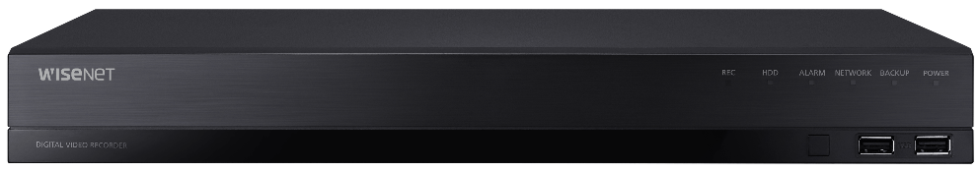
WAVE PoE NVR - Guide – Installing European languages in Linux
Contents:
What is Ubuntu?
Access Settings
Adding Keyboard Input Source
Adding a Language Pack

Slide 3

1. What is Ubuntu?
Ubuntu is a Linux distribution
Ubuntu is one of the most popular and recognisable Linux distributions in the world
What is Linux?
Open Source Operating System
    Open source code is freely available without charge
    In contrast to proprietary MS Windows OS
Stable
Widely supported
Ubuntu is based on the Debian tree of Linux distributions

Slide 4
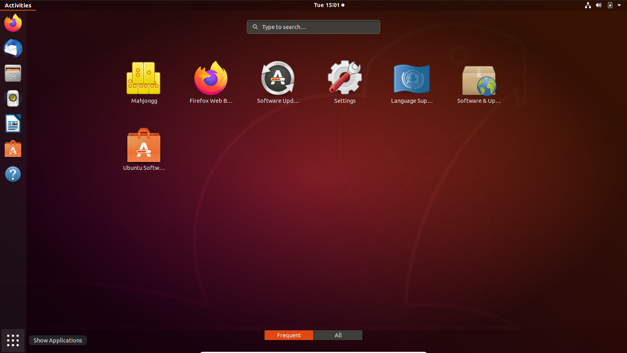
2.1. Access Ubuntu Settings
  Power on and log into the WAVE PoE NVR
  Go to Ubuntu Settings in any of the following ways:
    1. Using keyboard:
    Press the Start key on your keyboard
      Same as the Windows key
    Type Settings and press Enter
    2. Using mouse (1 of 2)
    Click on the 9-dot icon
    Click Settings

Slide 5
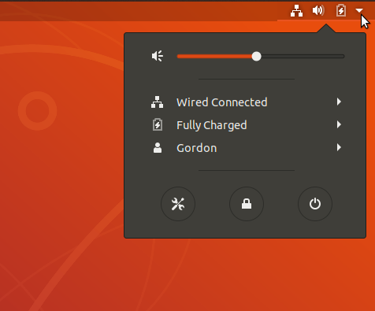
2.2. Access Ubuntu Settings
    3. Using mouse (2 of 2)
    Click on the down-facing arrow in the top right hand corner
    Select the Settings Icon

Slide 6
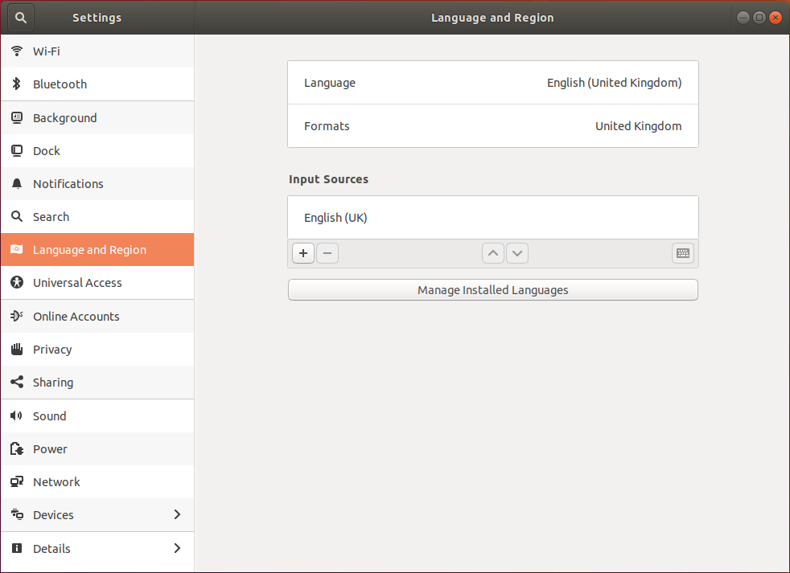
2.3. Ubuntu Settings
  Once selected the Settings window will appear
  Select the Language and Region menu on the left
  Both Keyboard layouts and Language packs can be added in this menu

Slide 7
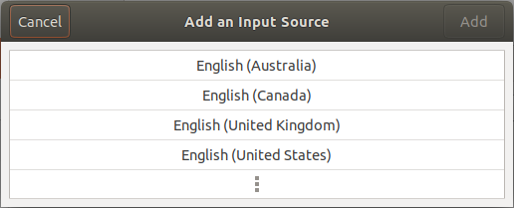
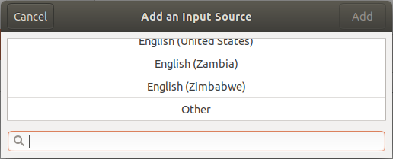
3.1. Adding a Keyboard Layout 1/3
1
  Under Input Sources click the “+ “ button
2
  In the Add an Input Source dialogue click on the 3-dot icon
3
  Scroll to the end of the list and select “Other”

Slide 8
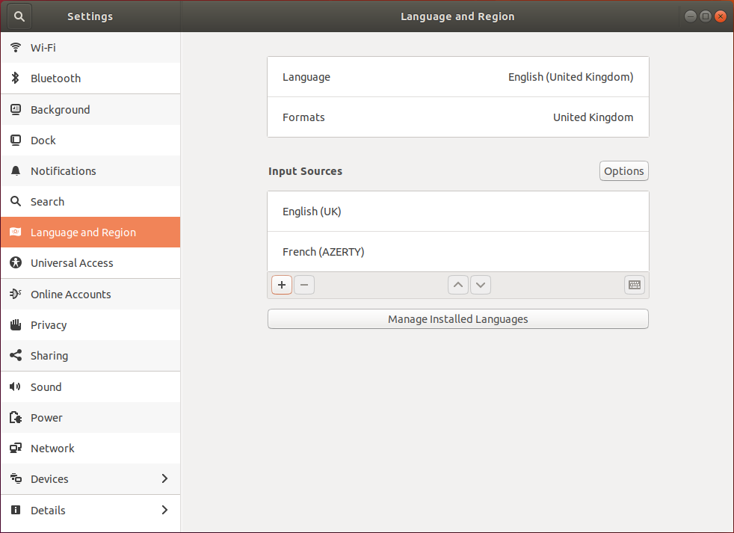
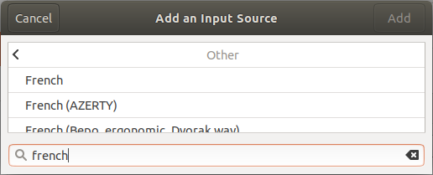
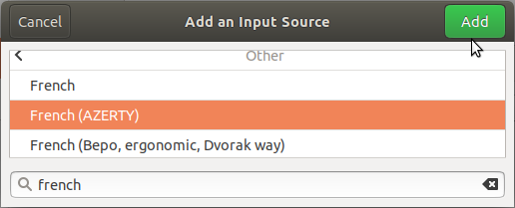
3.2. Adding a Keyboard Layout 2/3
4
Type in your language or browse the list for your input source
5
Select the input source and click “Add”
6
You should now see your input source in the Language and Region list

Slide 9
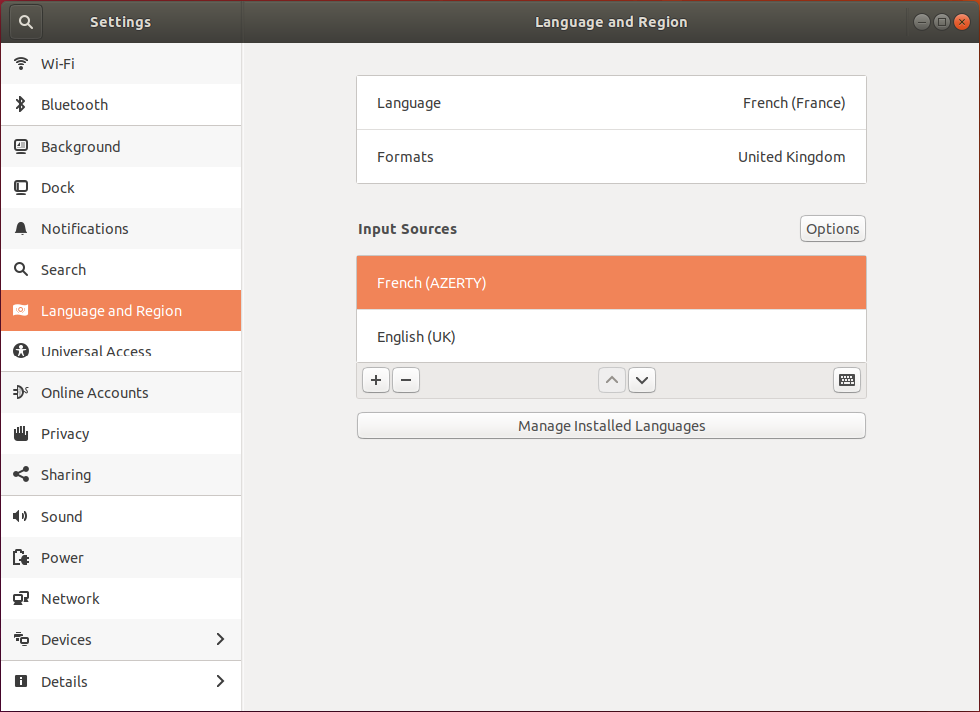
3.3. Adding a Keyboard Layout 3/3
7
Select your language and click the ^ arrow to move it to the top.

Slide 10
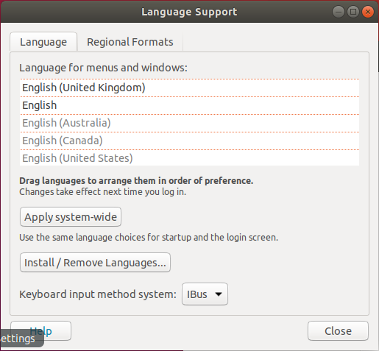
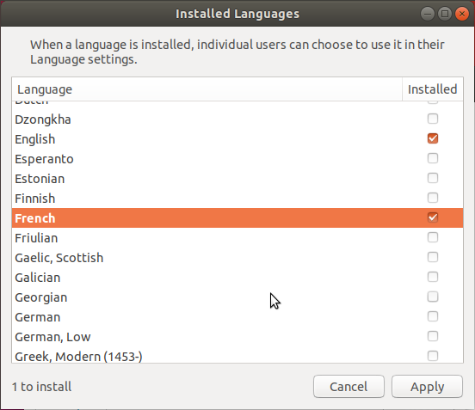
4.1. Adding a Language pack to Linux 1/3
1
  Select “Manage Installed Languages” button in Language and Region of the Settings menu
2
  The Language Support window will appear, click the “Install / Remove Languages…” button
3
  The Installed Language window will open, scroll to your required language and select the checkbox

Slide 11
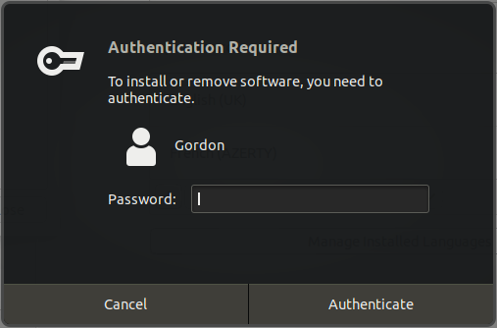
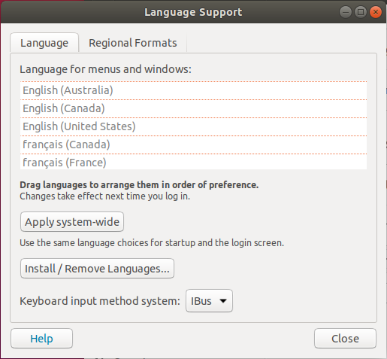
4.2. Adding a Language pack to Linux 2/3
4
  Click “Apply”
5
  Enter your password to allow permission to install the language pack
6
  Wait a moment for the download and install to complete. Scroll the language list to confirm installation.

Slide 12
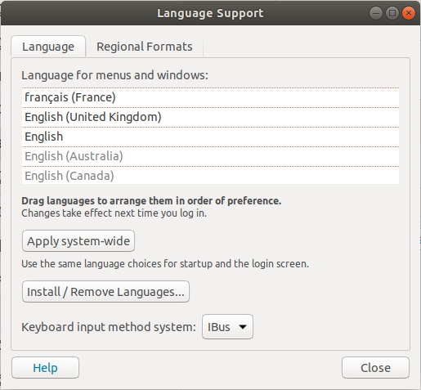
4.3. Adding a Language pack to Linux 3/3
7
  Drag the language up the list to increase its priority.
8
  Click the “Apply system-wide” to apply this priority.
9
  Input your password to apply permission to this change

Slide 13
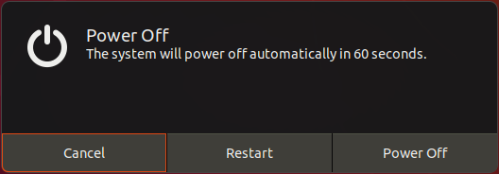
4.4. Adding a Language pack to Linux 4/4
10
  Confirm the settings have been saved.
11
  Restart the WAVE PoE NVR to complete the change of settings.
  To restart first select the down-facing arrow in the top right corner.
12
  Click on the on-screen power button.
  Select “Restart” to reboot.

Slide 14

End of guide
For further support contact Hanwha Techwin Europe
    Tech support
    E-mail: eucctv.help@hanwha.com
    Product and Marketing: hteproduct@hanwha.com

